Slide 1
Introduction to Data Structures
By Shashanka Shekhar Das

Slide 2
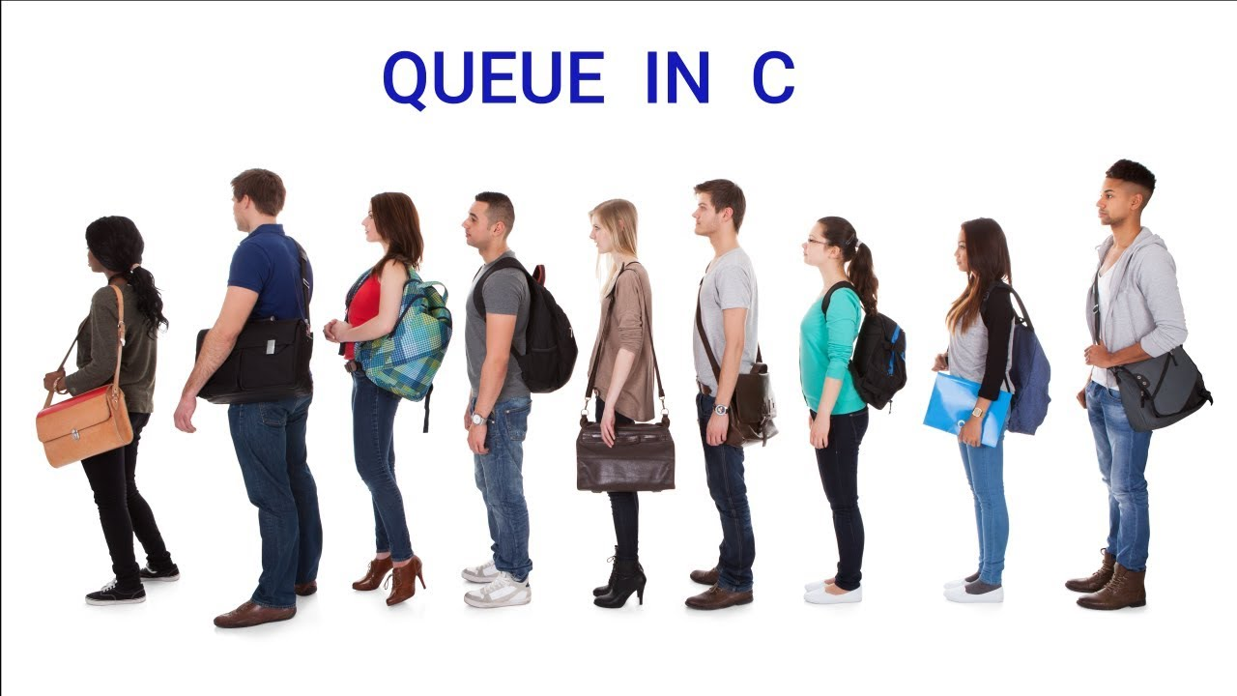
What are Data Structures
Data Structures are nothing but ways of storing data in the memory. There are many different data structures and these are used depending on the need. Some common examples are : Stacks, Queues, Trees, Graphs etc

Slide 3


Reasons to use DS

Slide 4
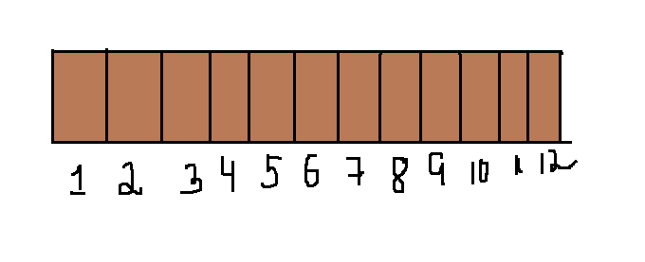
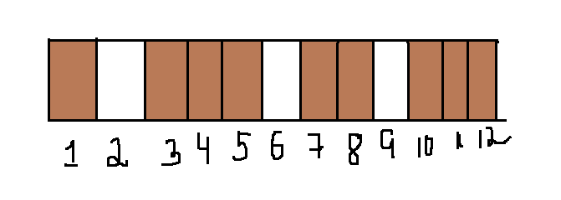
To have proper storage and usage of memory

Slide 5
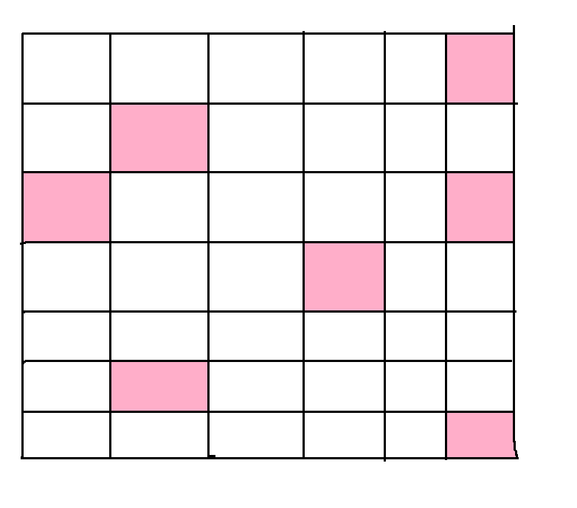
2) To have efficient use of memory

Slide 6
What are Algorithms?

Slide 7
Algorithm to make a veg sandwich 1. Buy Bread 2.Cut Crusts 3.Toast the Bread 4.Add vegetables, cheese, salt as required. 5.Sandwich is ready This is an Algorithm to make a veg sandwich.

Slide 8
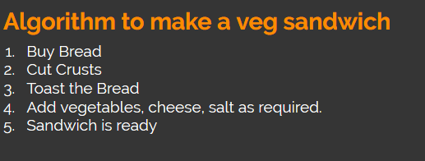
A process or set of rules to be followed is called an Algorithm. Simply, the steps to be followed to achieve the final objective is an algorithm.

Slide 9
Examples
Searching algorithms Searching across memory to find a file.
Finding shortest path from one point to other Like shortest distance from AB1 to AB2.

Slide 10

Examples of DS
Stacks : Normal stacking, which we know of. One over the other, we remove from top/ add to the top.
Queues : Like queues in movie theatres, people enter at the end to buy tickets and the front person gets the ticket first

